Slide 1
Introduction to DevOps : Part - 2
By, Ganesh Palnitkar

Slide 2
DevOps Habits
DevOps start with getting the two sides (Dev and Ops) to talk to each other. Talking face to face breaks down stereotypes and allows each side to see the other's daily difficulties and struggles.
Find out command goals – Stable Production environment- what each team has to do to achieve this?
Automate most of the processes. Eliminate human intervention wherever possible. Make use of configuration management tools like Chef, Puppet, Ansible, etc.
standardize the Development and Production environments. Revamp server infrastructure as needed.
Implement feedback and feed-forward loop. Involve all stake holders from beginning.

Slide 3
Infrastructure for successful
DevOps
DevOps – Team structures.
Close-knit collaboration between Dev and Ops. Highly collaborative team working side by side.
Dedicated Dev-Ops team- skilled people with diverse expertise on DevOps tools.
Cross-functional team – representatives from all disciplines responsible for developing and deploying a service (business Analyst, developers, quality engineer, ops and security, etc.) the team is fully empowered and self-sufficient.

Slide 4
DevOps - Infrastructure Components
DNS optimization– important aspect of your enterprise network for faster performance.
Domain Name service that translates Hostname to IP Address or Domain name to IP address.
Data packets traverse the Internet and reach their destinations on the network of DNS servers. They hop from server to server, asking each server along the way for the correct route towards the target computer. This is called “routing”.
The routing of packets along the most efficient DNS servers is optimization.
DNS servers should be benchmarked and then cleaned up for efficient routing resulting in significantly reduced browsing time
4

Slide 5



DNS – Domain Name Service
Helps to Map domain names to IP-address
The client asks its DNS server to resolve a host name to am address.
The DNS server queries and gets hints on where to find the record for the hostname from the Root and Top-Level DNS server which lead to the DNS server with the authoritative host IP Address.
The DNS server returns the IP Address information to the client and stores the information in local cache.
Root DNS Server
Top Level DNS Server
Local DNS server
Requesting Host
Authoritative DNS Server
On Linux flavor machine, BIND9 is one of the favorite application used for configuring the server / machine as dns server.
Forwarder and reverse zones are configured on DNS server while configuring the DNS server.
Advantages:
Improves network query speed, caching feature helps in reducing repeated network trips.

Slide 6




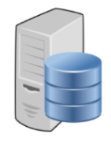



Load Balancer
Possibilities of failure
No Load Balancing
User
Internet
Web Server
Database Server
Layer -4 – Transport Layer
Load Balancer
Web Servers
User
Load Balancer
Web Servers

Slide 7
Load Balancer
Application level Load Balancer
Dynamic ratio – connection are distributed as per ratio derived based on real time server performance.
Observed – this method tracks the number of connection to each node over the time and creates a ration of load balancing.
Predictive – this method analyses the trend of ranking of servers rated upon number of connection over the time.
Classic Load Balancer.
Round Robin – default load balancing mechanism – used when all servers have equal processing speed and memory.
Ratio – connection are distributed as per defined ‘ratio of connections’ per node.
Fastest node – Server selected based on least number of connection of the session.
Least connections – passes the connection to the node having least number of active connection.
Weighted connection – the connections are established depending upon the weighted server capacity.

Slide 8
Commonly Load Balancer – Hardware or Software-based load balancers
F5 BIG-IP – Major feature - WAN optimization manager. enables traffic between data-centers to be optimized, encrypted and highly available. This feature makes creating a WAN-based disaster recovery (DR) solution easy and almost automatic.
CISCO – Hardware routers and CISCO IOS has every possible load balancing feature available.
CITRIX NetScaler – NetScaler ADC (application delivery controller) helps to automate network provisioning and control based on app requirements and policies for data-centers and enterprise environments.
KEMP – offers hardware and virtual (software) load balancers. Offers a freeware version of software based load balancers (LoadMaster).
Radware – hardware load balancers - Some notable features of ‘Radware’ devices are easy updates and upgrades, application-aware services, and improved application response time through smart caching.
Zen Load Balancer – Software based Load Balancer.
HAProxy – Software based Load Balancer
NGINX – Software based Load Balancer.
Amazon ELB (elastic Load Balancing) - Software based LB.
Most commonly used open source Load balancer solution

Slide 9
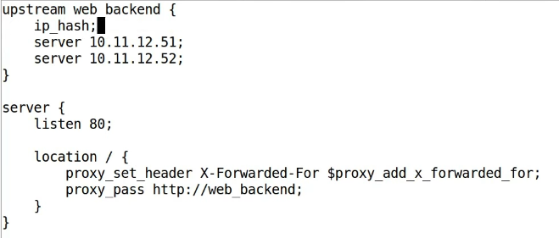
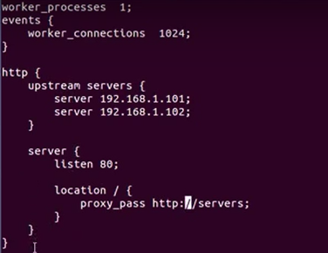
NGINX – Load Balancer
NGINX provides three options with load balancing. This needs to be mentioned in the configuration file for NGINX.
round-robin
default
Least-connected
least_conn;
ip-hash
Use for sticky session
ip_hash
The default configuration file resides at ‘/etc/nginx/sites-available/default’

Slide 10
HAProxy – Load Balancer
haproxy.cfg
High availability Load balancer, Fault Tolerance
Highlights:
Software based load balancer.
Used for load balancing only, unlike NGINX, which is used as webserver as well.
Works on TCP layer-4 and HTTP layer-7.
Has faster performance as compared to similar Apps.
Has advanced routing and load balancing features.
Works / support native SSL
Works only with open source (Linux flavors), no Windows Support.
Has Admin console to manage.
Used with some well known web sites as, GitHub, Reddit, Tumblr, Twitter etc.
global
log dev/log local0
log
defaults
log global
mode tcp
option tcplog
option dontlognull
timeout connect 5000
timeout client 50000
timeout server 50000
errorfile 400 /etc/haproxy/errors/400.http
frontend myfrontend
bind *:80
default_backend haproxy_http
backend haproxy_http
balance source
mode tcp
stick-table type ip size 20k peers mypeer
server web1 192.168.33.30:80 check
server web2 192.168.33.31:80 check
server web3 192.168.33.32:80 check
peers mypeer
peer ha1 192.168.33.101:1024
peer ha2 192.168.33.102:1024

Slide 11

NFS – Network File System
Uses Distributed file protocol
Used with Unix flavor machine. Also implemented for other Oss like, Mac OS, Windows, AS-400, etc.
Allows users to share file and directories
RPC Based
Simple crash recovery –
Each RPC from client all necessary information for the operation
Server doesn’t maintain any client related information.
Server doesn’t keep track of past access records.
User
Local File access
NFS Client
NFS Server
Local File access
RPC
RPC
TCP/ UDP IP
TCP/ UDP IP
Client
Server

Slide 12
NFS – Network File System
Points to note:
For sharing files between Unix flavor machines.
Install NFS package
Modify configuration file located at /etc/exports.
Start services
1) nfs
2) nfs lock
3) portmap
---------
In order to use the nfs share the client should also be installed with nfs package.
On client run command,
$ yum –y install nfs*
And then mount the ‘nfs public’ folder,
$ mount <ip address of nfs server>:/<share_name> /mnt
Check the /mnt folder, and you will see the files inside the public share folder.
Install ‘nfs’ using below commands,
$ yum –y install nfs-utils nfs-utils-lib
Create a share repo.
$ mkdir pubshare
Create few file inside the directory.
Update file /etc/exports
/public * or, <ip address> (ro,sync) … save the file
$ service rpcbind status
To start the NFS service when the system boots, use the command,
$ chkconfig nfs on
Start the nfs service
$ service nfs start
To check the nfs file share, use command,
$ showmount -e

Slide 13
Thank You

